Slide 1
Cloud Native Application Development Services

Slide 2


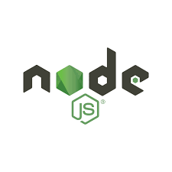



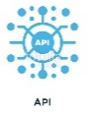



Cloud Native Application Services
Customer Challenges
Cloud Native Transformation Services
Outcome
Poor customer experience
Poor usability
Outdated business process
Omni channel
Regulatory compliance
Security vulnerabilities
Maintenance cost
Outdated hardware
Cloud migration strategy
New & refactored cloud native application
Business services as microservices
Microservices in containers
On Demand Scaling of Business Capabilities
Operation using Servicemesh
Mobile and social apps
Easy monitoring of hardware and Applications
Security hardened apps
Catalogue
Tool based assessment
Factory based industrial treatment
Kick start templates
Micro Services, Serverless and service mesh
Agile delivery
Application life cycle management
DevSecOps
Intelligent dashboards
Actionable insights
New Cloud Native Application
Development
API / UI Development
API / UI Development

Slide 3
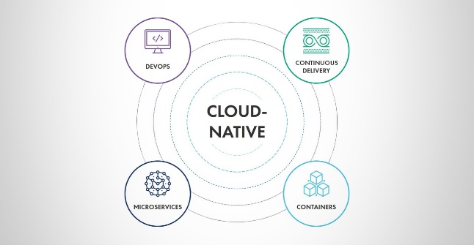

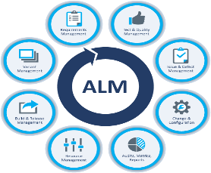
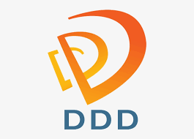
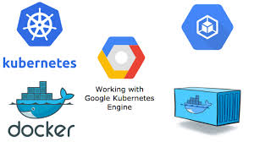


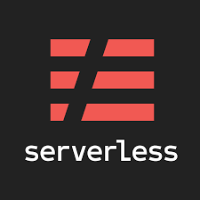
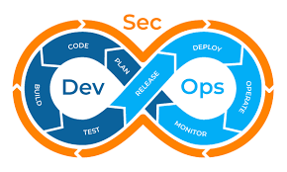
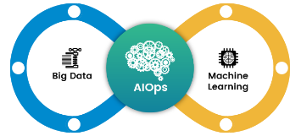

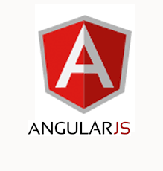
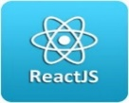

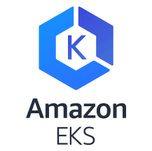
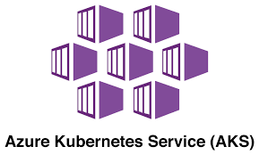
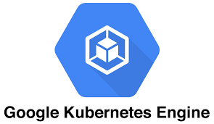
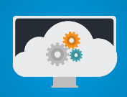

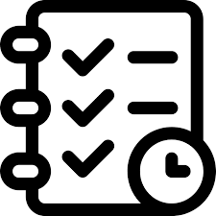





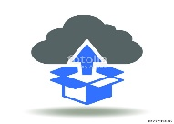


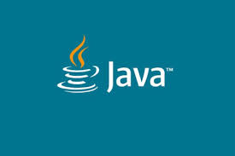

Cloud Native Application Services Factory
An industrialized factory based service to develop new cloud native applications and modernize legacy monolithic applications in to modern cloud native applications
Refactoring
existing application
New Development
Assess
Plan
Transform
Deploy
Operate
Optimize
Legacy Monolithic Applications
Cloud Native Application Factory
Cloud Native Apps

Slide 4
Dev Factory Life Cycle
Development Phases
Discovery & Assessment
Planning & Prep
Transform
Deploy
Operate
Activities
Understanding application criticality, business impact, stake holders mapping, regions/zones and security controls
Application Functional Analysis
Map the application modules
Map the external integration
DB architectural analysis, mapping and sizing
Workshops, Interviews with SMEs
Inventory application mapping
Develop Project Charter & Release Plan
Workload assessment
Testing plan & procedures
Roll back and back out plans
Event Storming workshops
Domain driven Design
Pattern Based Micro services
12 factor guidelines
Build API Economy
Business use case test script generation through AI based Application profiling
Infrastructure as Code
Create dev ops pipeline for continuous CI/CD implementation
Build Docker images
Create Infrastructure templates
Immutable Deployment
Automated Functional and Integration testing
Spinnaker Based Deployments for multi clouds/hybrid clouds
Monitor application health
Monitor infrastructure health
Identify bugs
Fix and deploy
Scan for security threats and anamolies
Provision auto heal for environmental issues
Identify and Resolve incidents
Collect measures and optimize
Quality Assurance
Determine current state
Test coverage
Applications functional stability
Testing tools & licenses available
Non-functional test types executed and availability of scripts
Application topology and deployment diagrams to plan for failover testing
Leverage the cloud monitoring tools/solutions for diagnosis
Required MQ/batch feeds for testing and data source information
API Request/Response samples and end point URLs for testing
Gather inventory of DB, Tables, data volumes to enable data testing
Cloud Agnostic Deployments
Immutable Infrastructure
Dev Sec Ops
Behavioral Driven Testing
Functional Testing
Cloud Performance Testing
Vulnerability Testing
Code Quality Analysis
Execute business use case validation
Diagnose errors and failures
Execute IAM testing
Execute data migration testing
Execute required non-functional testing types as applicable
Prepare a migration test summary report
Review and signoff
Differentiators

Slide 5













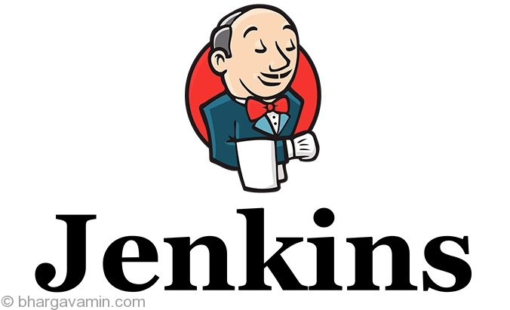

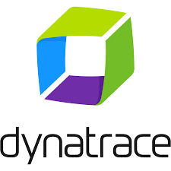



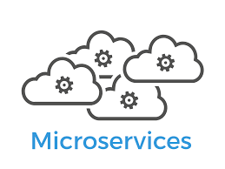


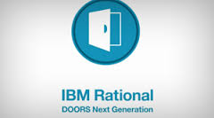
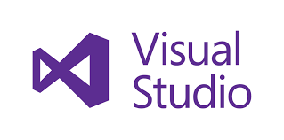
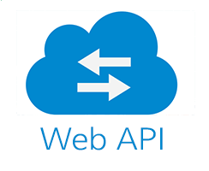




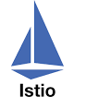
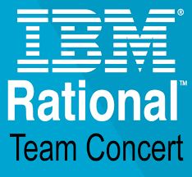





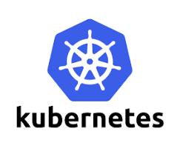


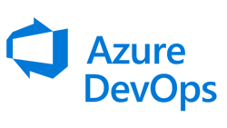
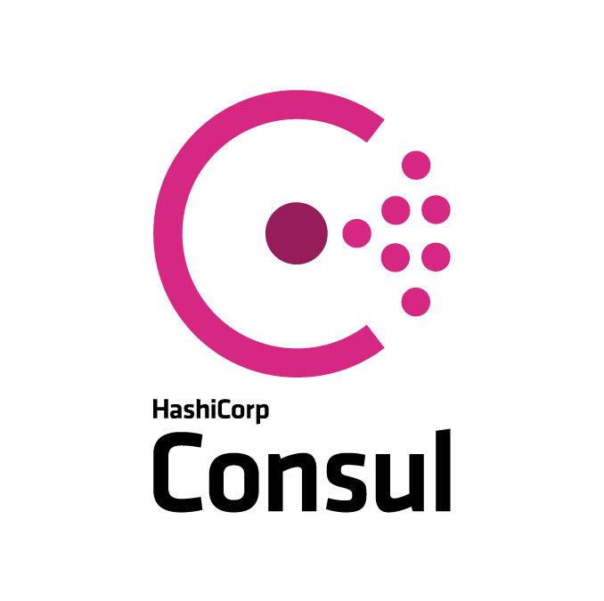

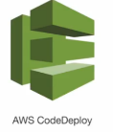
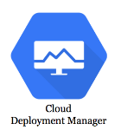
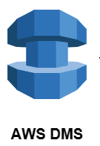

Hexaware Refactor Framework
Assess & Plan
Transform
Build & Deploy
Manage
Product Owner
Solution architect
Business Analyst
Solution architect
Business Analyst
Project Team
Devops Engineer
Network Specialist
Project Team
User Support
Administrator
AI
Azure DMS
Cloud Code

Slide 6











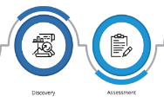



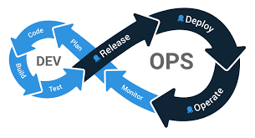








Understanding application criticality
business impact,
stake holders mapping, regions/zones and security controls
Application Functional Analysis
Map the application modules
Map the external integration
DB architectural analysis, mapping and sizing
Workshops, Interviews with SMEs
Inventory application mapping
Develop Project Charter & Release Plan
Workload assessment
Testing plan & procedures
Roll back and back out plans
Event Storming workshops
Domain driven Design
Pattern Based Micro services
12 factor guidelines
Build API Economy
Business use case test script generation through AI based Application profiling
Infrastructure as Code
Business Analyst
Product Owner
Solution architect
Product Owner
Solution architect
Solution architect
Business Analyst
Project Team
Azure DMS
Business Analyst
Discovery & Assessment
Plan
Transform
Transform
Create dev ops pipeline for continuous CI/CD implementation
Build Docker images
Create Infrastructure templates
Immutable Deployment
Automated Functional and Integration testing
Spinnaker Based Deployments for multi clouds/hybrid clouds
Monitor application health
Monitor infrastructure health
Identify bugs
Fix and deploy
Scan for security threats and anamolies
Provision auto heal for environmental issues
Identify and Resolve incidents
Collect measures and optimize
Operate/Manage
Build & Deploy
Devops Engineer
Cloud Code
User Support
Project Team
AI
Network Specialist
Administrator

Slide 7
Questions

